Slide 1


WG1. Scoping the needs of open science monitoring
2nd WG meeting
May 8, 2025

Slide 2

Agenda
Brief Recap of WG1 Kickoff Meeting (March Meeting)
  Overview of WG1 objectives and key discussion points
Review of Identified Monitoring Needs
  Summary of Wooclap brainstorming results
  Highlight of emerging themes and priorities
Presentation of the Excel Tracker and Collaborative Work Session
  Walkthrough of the organized needs by pillar
  Live input and discussion for updates
Subgroup Selection Process
  Explanation of subgroup themes aligned with OS pillars
  Introduction of Google Form for subgroup selection
  Timeline for subgroup formation
Next Steps
  Open feedback and next steps for development
  Subgroup work to begin post-meeting
WG1. Scoping the needs of open science monitoring​
3

Slide 3

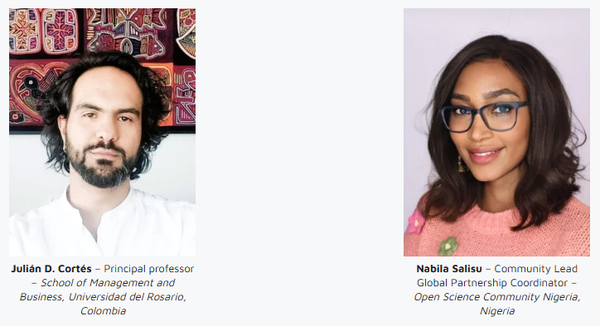
Co-chairs introduction

Slide 4
Recap of WG1 Kickoff Meeting
🔍 WG1 Scope and Goals
  Understand the needs for Open Science (OS) monitoring globally.
  Identify gaps and challenges across regions and stakeholder groups.
  Provide foundational input for future Open Science monitoring frameworks.
  Ensure inclusivity, diversity, and alignment with UNESCO OS principles.
🎯WG1 Objectives
  Gather and map the diverse needs and gaps in Open Science (OS) monitoring across regions, disciplines, and stakeholder groups.
  Develop a common understanding of what needs to be monitored in OS and why, aligned with UNESCO’s Open Science principles.
  Ensure that the perspectives of underrepresented regions (e.g., Africa, MENA, Asia-Pacific) are reflected in monitoring needs and priorities.
  Produce a structured output (e.g., scoping report, policy recommendations) that can inform future Open Science monitoring frameworks at national, regional, and global levels.
  collaborate closely with WG2 Understanding the OS monitoring landscape
📊 Membership Snapshot (as of March 3, 2025)
  68 confirmed members from around the world
  Regional distribution:
    Africa: 10 | Asia: 9 | Central/South America: 4
    Europe: 40 | North America: 4 | Oceania: 1
    Majority from universities and research institutions (30 members)
    Also includes libraries, data services, infrastructures, publishers, funders, policymakers, IGOs, NGOs, and private sector organizations
WG1. Scoping the needs of open science monitoring​
3

Slide 5
Review of Identified Monitoring Needs
Key Themes Identified from the Wooclap brainstorming activity
➔ Lack of Shared OS Definitions
  Need for common understanding across disciplines and regions.
🚀 Next Steps:
  We Organized these needs into topics based on OS UNESCO principles to guide WG1 deliverables.
➔ Language and Accessibility Barriers
  Limited availability of OS tools and resources in multiple languages.
➔ Fragmented Regional Monitoring Efforts
  Lack of coordination across local, national, and international initiatives.
➔ Absence of Standardized Baseline Indicators
  Need for a core set of indicators to enable consistent and comparable monitoring.
4
WG1. Scoping the needs of open science monitoring​

Slide 6
Subgroup Selection Process​
Step 1: Map Needs to OS Principles
Step 2: Invite Members to Choose Their Subgroup
Step 3: Form Subgroups
Step 4: Begin Subgroup Activities
  Organize the identified monitoring needs.
  Align each need with the relevant UNESCO Open Science (OS) pillars.
  Members choose based on personal interest, expertise, and aligned OS pillars.
  Group members based on their selection results.
  Ensure diversity across regions, disciplines, and expertise areas.
  Subgroups will work on refining needs, proposing actions, and contributing to the WG1 deliverable.
5
WG1. Scoping the needs of open science monitoring​
Notes:
Interactive map: https://coggle.it/diagram/aA_sdMeQzBRMWNof/t/-/b2cf99f75742cc70646eb20956e5ecdc207607a67e3b28c7e242c9935a8ccde2
Subgroups poll: https://docs.google.com/forms/d/e/1FAIpQLSfhP1sR5xxYG2GVhHYuYzez_IRs6Ylkmm2O-YO_vHh_7vSKog/viewform?usp=sharing

Slide 7
Next Steps
We will send out a new Doodle poll to propose additional time options that better accommodate Asia-Pacific members for our next WG1 meeting.
We will also invite members to participate in an open discussion during the next session to:
• Share feedback on subgroup themes
• Align on deliverable structure
• Identify contributions across subgroups
In the meantime, the subgroup selection form remains open—please submit your response if you haven’t yet.
WG1. Scoping the needs of open science monitoring​

Slide 8

Questions?

